Slide 1
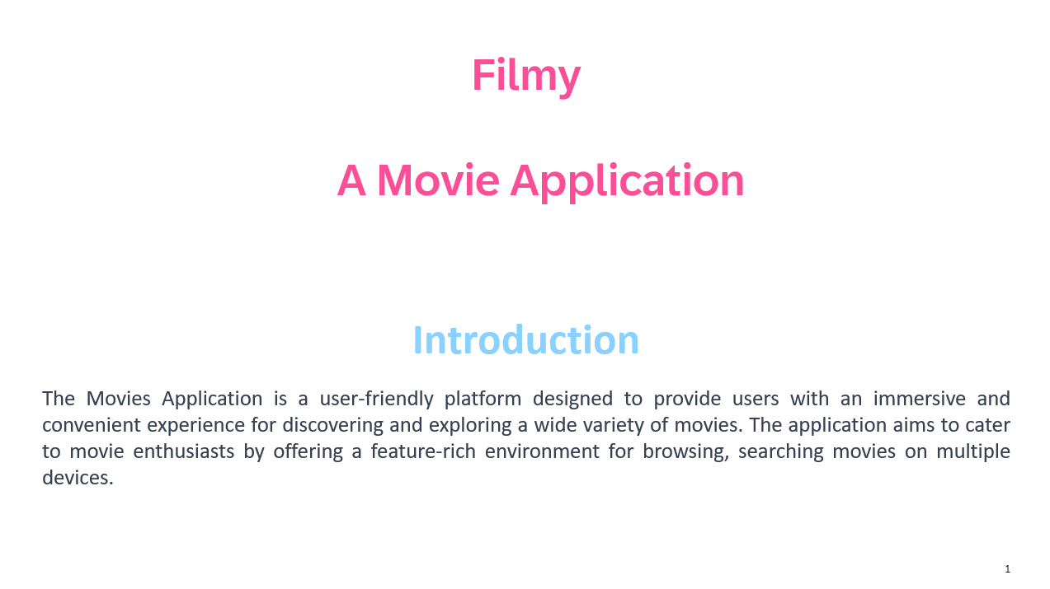
I Movies Application
1. Introduction
The Movies Application is a user-friendly platform designed to provide users with an immersive and convenient experience for discovering, exploring, and enjoying a wide variety of movies. The application aims to cater to movie enthusiasts by offering a feature-rich environment for browsing, searching movies on multiple devices.

Slide 2
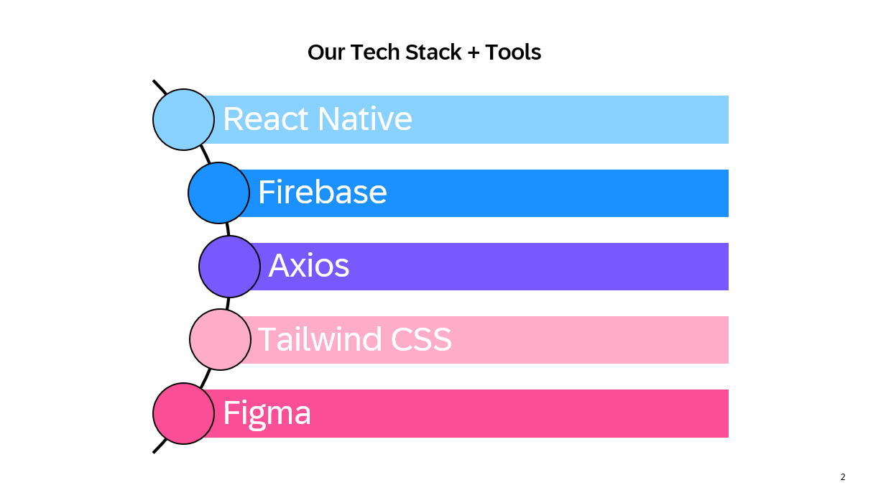

Slide 3
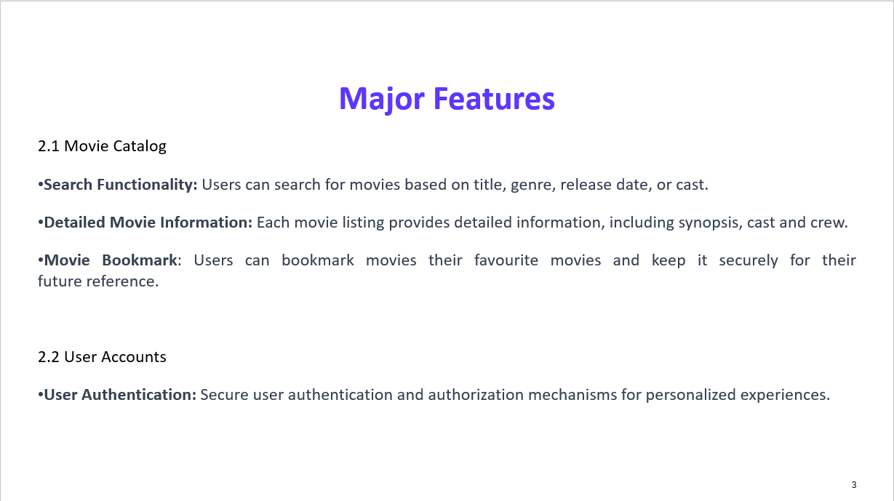

Slide 4
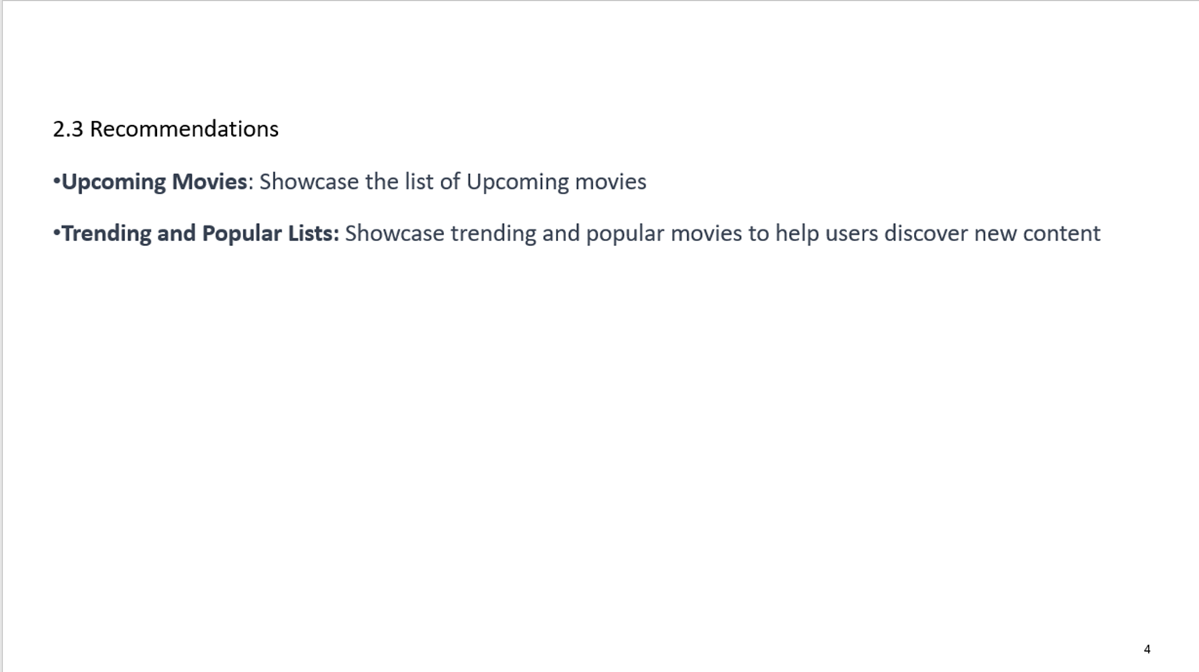

Slide 5
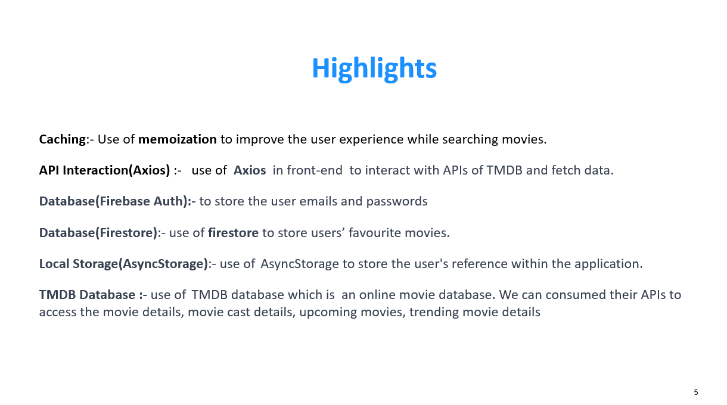

Slide 6
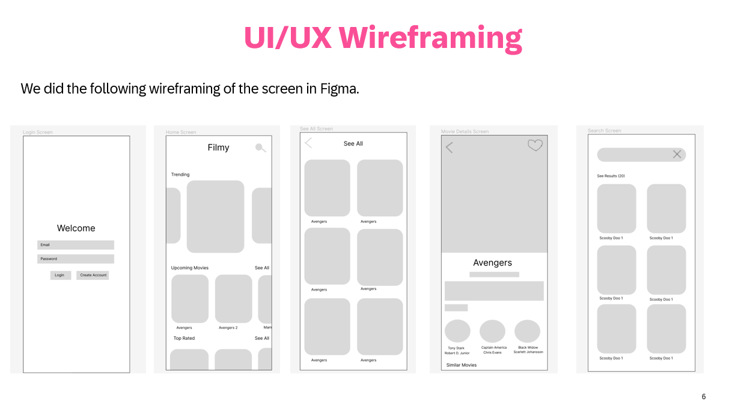

Slide 7
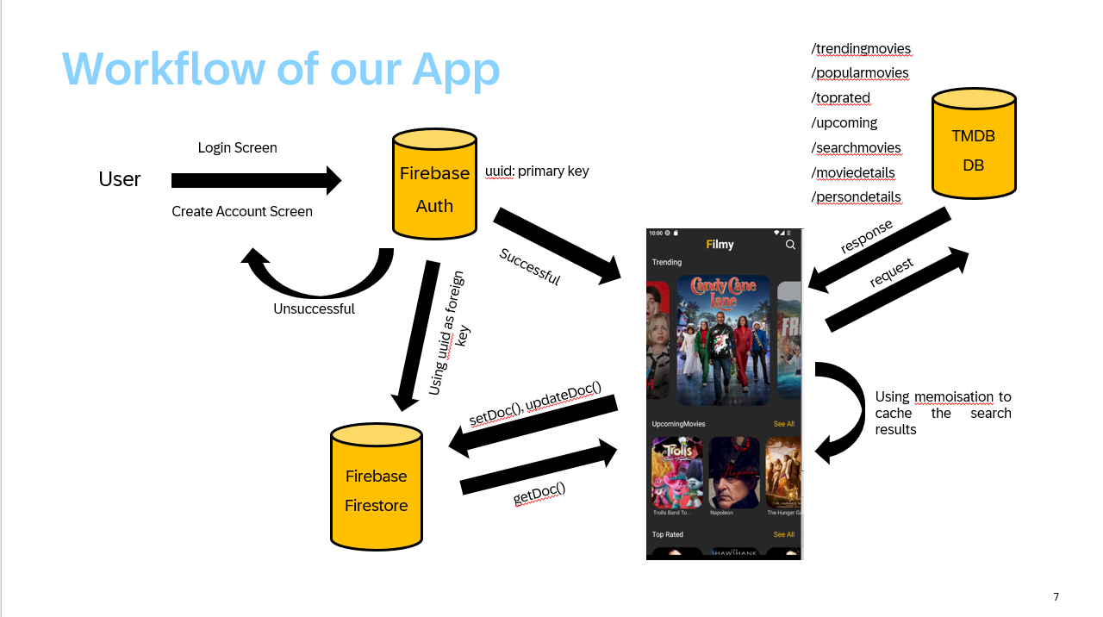

Slide 8
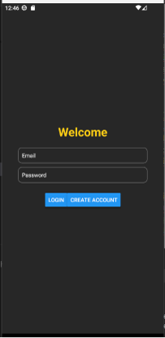
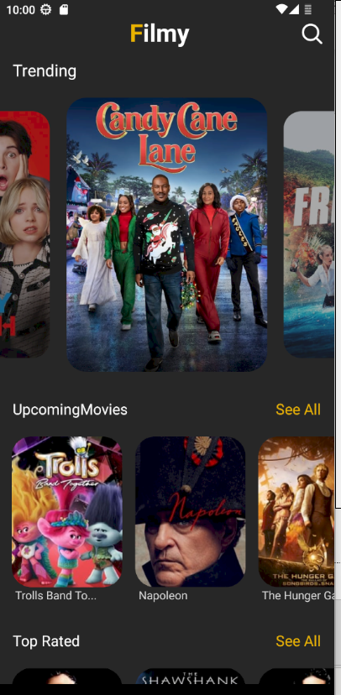
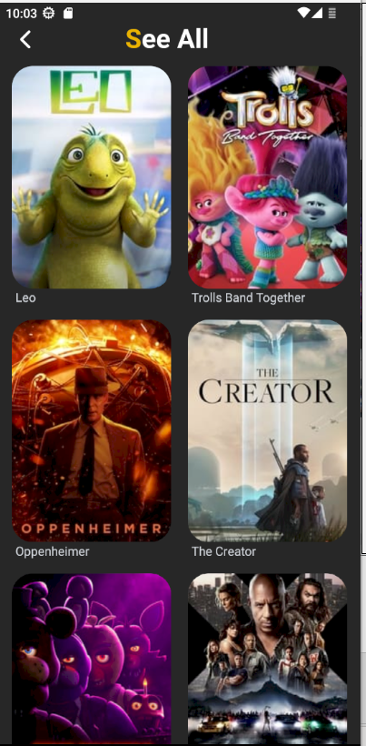
Welcome Screen
Home Screen
View All Screen

Slide 9
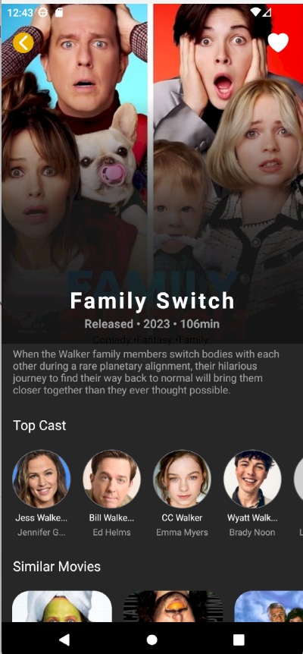
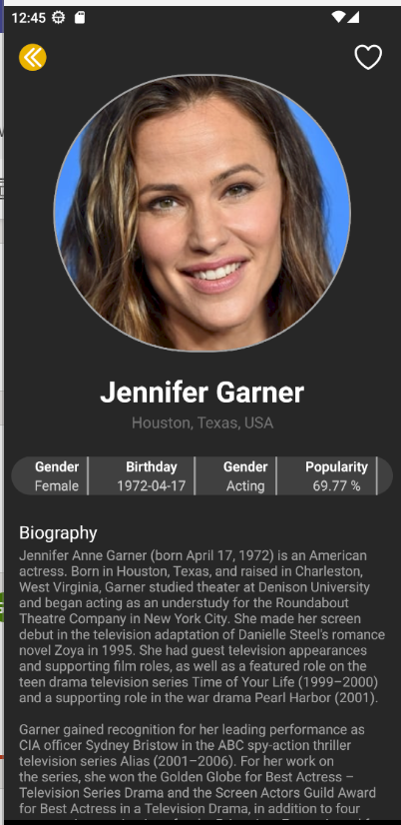
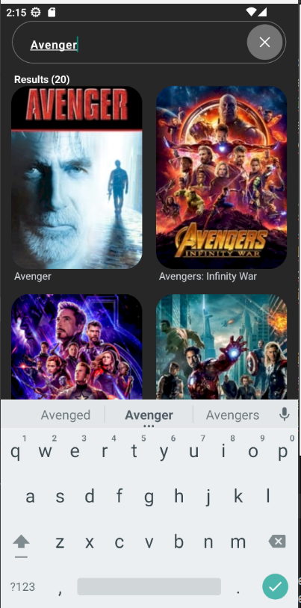
Movie Screen
Cast Details Screen
Search Screen

Slide 10
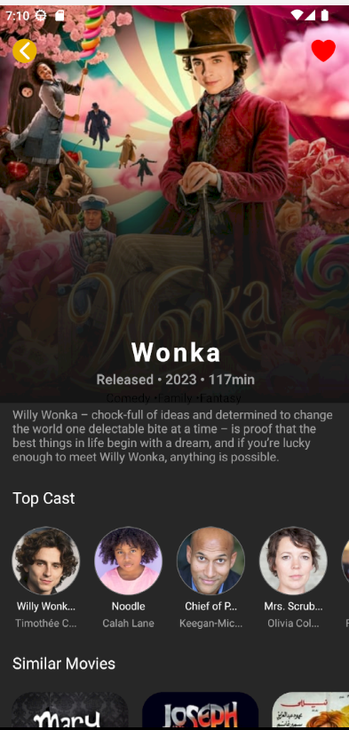
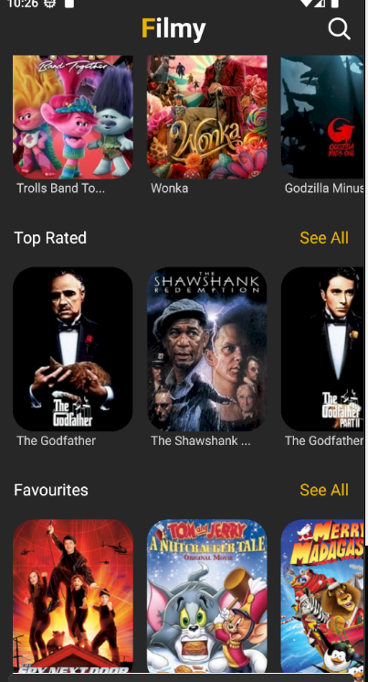
Movie added to favourite
List of favourite items on home page

Slide 11
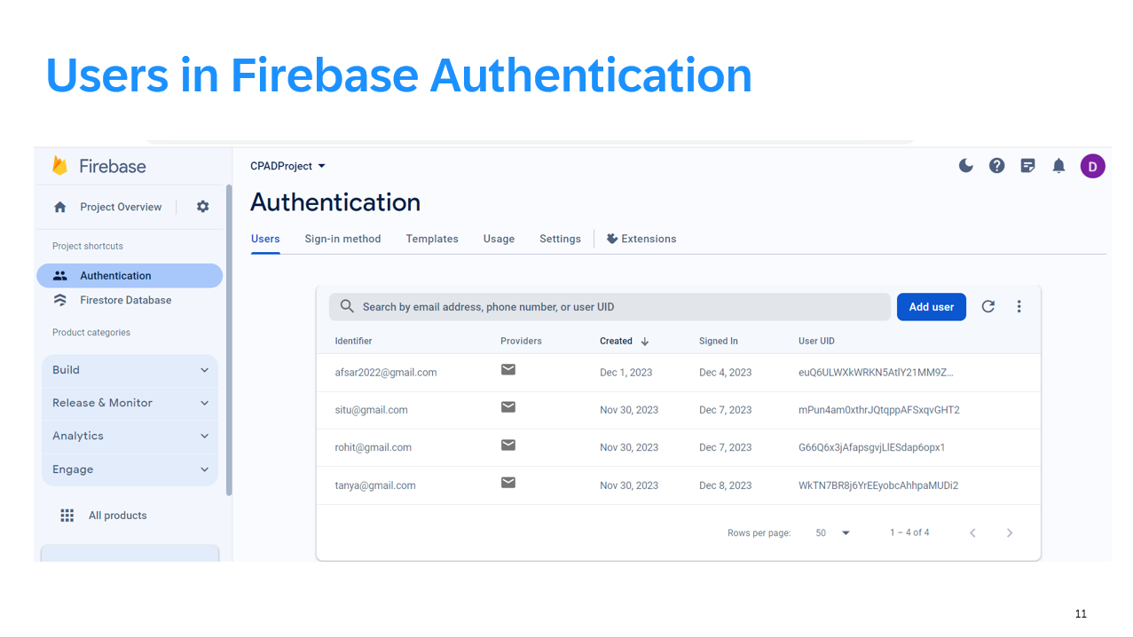

Slide 12
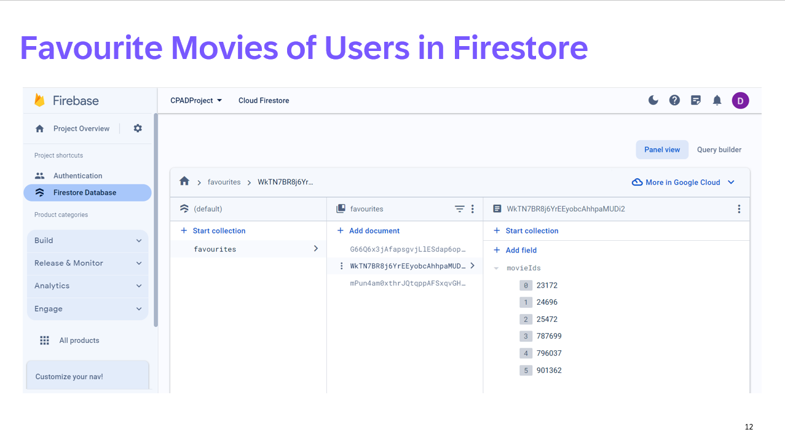

Slide 13
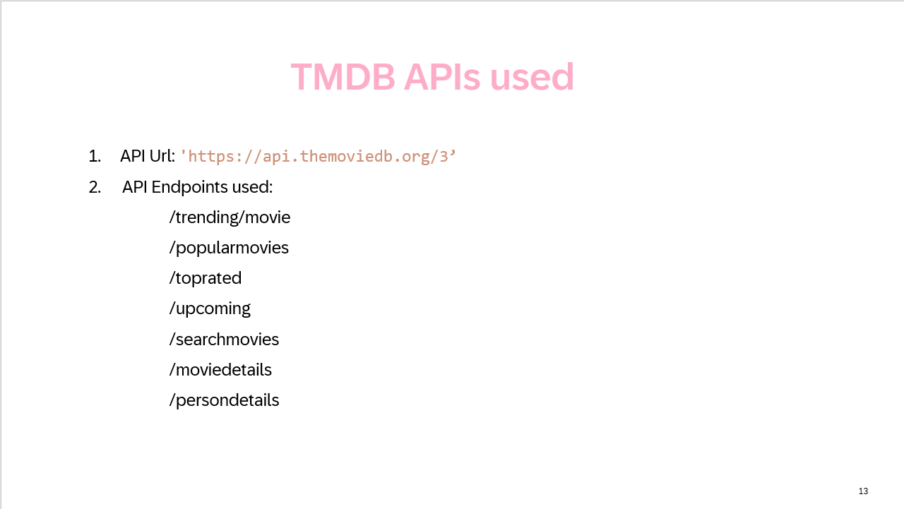

Slide 14
Conclusion
The Movies Application aims to deliver a comprehensive and enjoyable movie-Exploring experience for users, combining a user-friendly interface, powerful search and recommendation features, . This design document provides a roadmap for the development and implementation of the application, ensuring a seamless and engaging experience for movie enthusiasts.

